Slide 1
Lecture 7
Turns
Collagen
Stability of Protein Folds
Lecture 7 Learning Outcomes:
Beta turns
Describe how beta turns are defined (4 amino acid residues, i+1 and i+2 phi,psi torsion angles)
Identify beta turn positions where Pro is favored or where Gly is required
Collagen
      Describe the structure of Collagen (primary, secondary, tertiary, quaternary)
      Describe collagen synthesis (what occurs inside vs. outside the cell)
      Explain link between Vitamin C deficiency and Scurvy
      Identify what amino acid sidechains undergo post-translational modification (hydroxylation, crosslinking) and where (inside vs. outside the cell) these modifications happen.
Protein Folds
List the main categories of folds (e.g., all alpha, all beta, etc.)
Give reasons for the limited number of unique protein folds.
Describe what a topology diagram shows

Slide 2
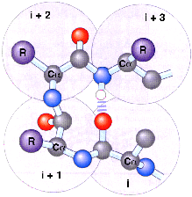
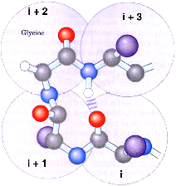
Turns: 4 AA are the minimum for a chain to turn 180º and a type of II structure
“Turns” allow the polypeptide chain to reverse direction.
They are defined by the (i + 1) and (i + 2) Φ,Ψ
Definition: < 7 angstrom between Cα(i) and Cα(i+3)
These four AA do not have repeating Φ,Ψ values!
Names: β-turn, tight turn, reverse turn
Most turns at protein surface. Small proteins ~ 1/4 of all AA in turns.
Are there other secondary structures?!
Various “rules” have been found:
Only Gly
α-helix, β-sheet, and turns
account for only ~ 60% of all AA in proteins!
2 different cases:
C
_{j} Other ~40% not random Φ,Ψ values! Instead, simply not repeating φ,ψ values.
H-bond
Jargon: non repeating Φ,Ψ parts of proteins, i.e. not turns or helices or sheets, are called “coil” or “loop”. These "coils/loops" also make all possible H-bonds.
N
Type I Type II
_{k} Some proteins are “intrinsically disordered”, with parts or even the entire protein not having fixed structure.
Pro common
AA in turns often polar/charged: Why?! At surface, in contact with water
Types I & II most common. Ten types now identified

Slide 3
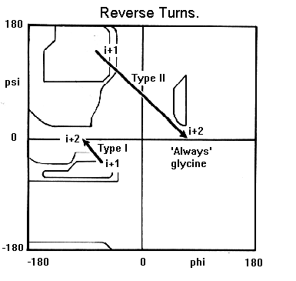
More on turns
~ 25% of turns have no H-bond to stabilize the turn! Many turns are at protein surface where H-bonds are made to water, instead of within the turn.
AA i + 1 and i + 2 define, or “make the turn”, and have particular Φ, Ψ values;
How to read where these turns show up on a Ramachandran map:
➢
Note that the Φ, Ψ values do not repeat for the consecutive i + 1 and i + 2 turn AAs
➢
➢
Φ, Ψ values for i + 1 i + 2
Type I -60º, -30º -90º, 0º
➢
Type II -60º, 120º 80º, 0º

Slide 4


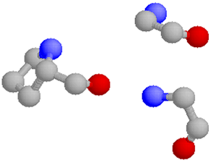
“Special” secondary structure: Collagen
(Gly-Pro-Pro)_{n} = artificial collagen
Repeating Φ, Ψ = -60º, +140º (similar to polyproline type 2 helix!)
In fish scales, animal hides (skin)
Heat collagen in water:
  Chains come apart and make lots of H-bonds with water gelatin
=
Most abundant protein in mammals! 30% total body protein; found outside of cells: skin, tendon, bone, blood vessels, cornea; a main component of extracellular matrix
Triple helix: tropocollagen
NOT an α-helix!
Only Gly can fit in center of triple helix!
OH
CH
CH₂
CH₂
OH
Pro fits well with Φ, Ψ = -60º, +140º
+
N
CH
CH₂
CH₂
CH
CH₂
NH₃
Many chem. modifications connected to later cross-linking: hydroxy-Pro and hydroxy-Lys; glucose and galactose then added to hydroxy-Lys
“Immature” form of collagen secreted from cells. Outside cell, Lys is oxidized and cross-linked insoluble fiber
Gly NH
Heat collagen dry to 63ºC, chains come apart 1st degree burn (sunburn)
Inside the triple helix

Slide 5
Collagen synthesis and how it gets outside the cell
LUMEN OF SMOOTH ER
Synthesis on ribosomes
SUGARS
Hydroxylation requires ascorbic acid (Vit C). If not Scurvy*
TRANSFER VESICLE
Inside cell
LUMEN OF GOLGI
Sugars added
PROCOLLAGEN
Vesicles of endoplasmic reticulum containing collagen pinch off, fuse with Golgi
Outside cell
SECRETORY VESICLES
Triple helix tropocollagen forms in Golgi
Vesicles of Golgi containing triple helix pinch off, fuse with plasma membrane
PLASMA MEMBRANE
Outside cell, collagen “trimmed”
Final, crosslinked form of collagen outside the cell
Outside cell, collagen is “trimmed” by enzyme -catalyzed hydrolysis
Most simple collagen crosslink:
Most simple collagen crosslink:
* Box 4-2 in eBook (Nelson & Cox), “Why Sailors, Explorers and College Students Should Eat Their Fresh Fruits and Vegetables

Slide 6
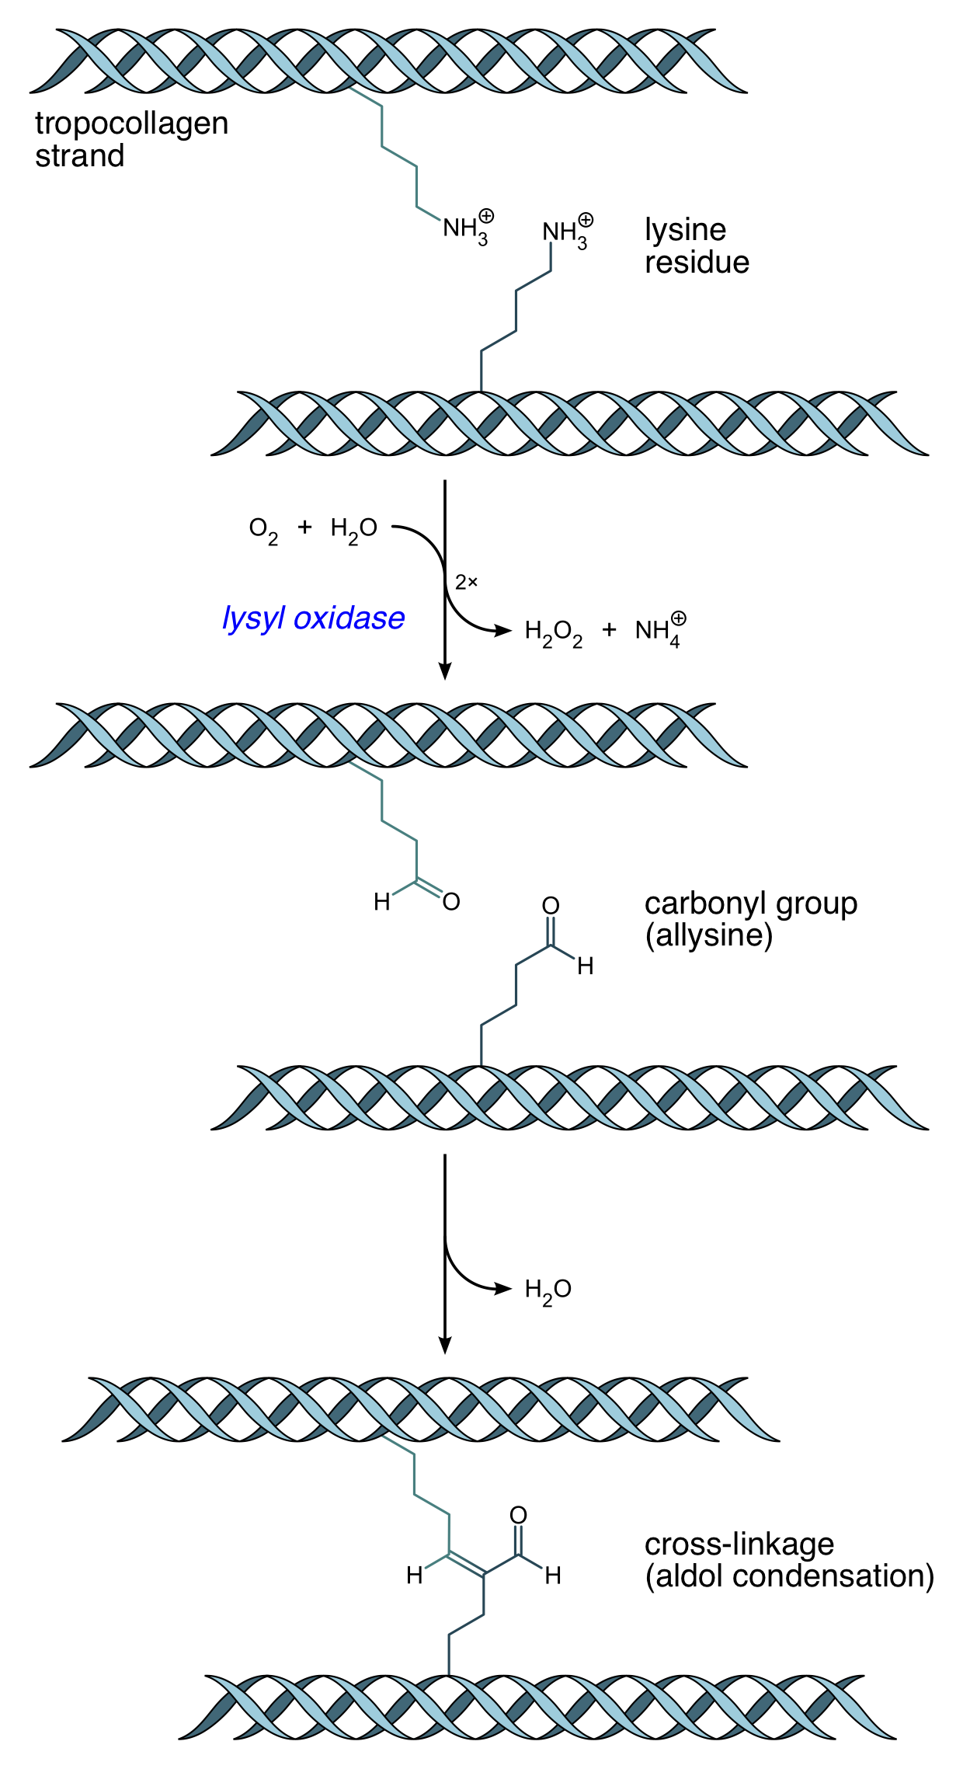
How does this crosslink form?
An enzyme!
→ Hydrogen Peroxide and Ammonium
aldol condensation → water
https://en.wikipedia.org/wiki/Collagen#Chemistry

Slide 7
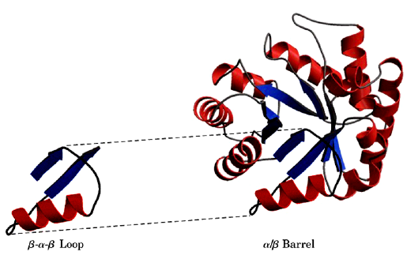
New topic: what is a stable protein fold?
How do α-helices, β-sheets, and turns fit together to form stable structure?
We will mainly use the term “fold” to describe the stable pattern of the protein’s structure
Not very stable by itself; Can unfold in water
A stable fold
Stable folds are also known as: structural domains or motifs or folding units
The word “domain” is used in different ways! Domain can also mean a part of a protein having special binding or function.

Slide 8
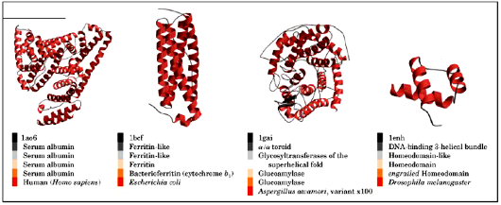
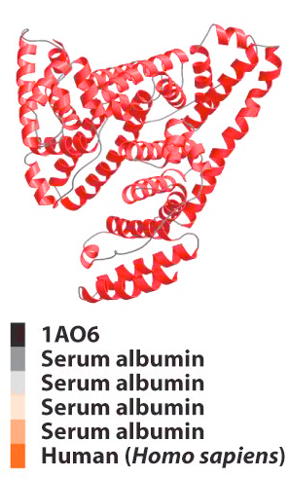
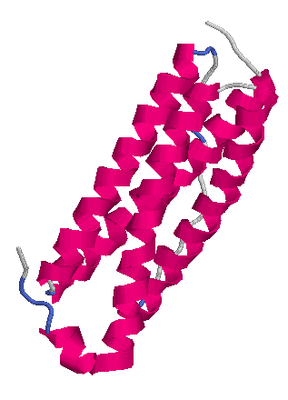
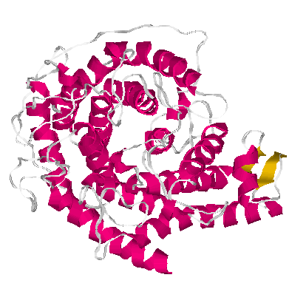

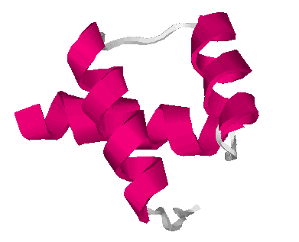
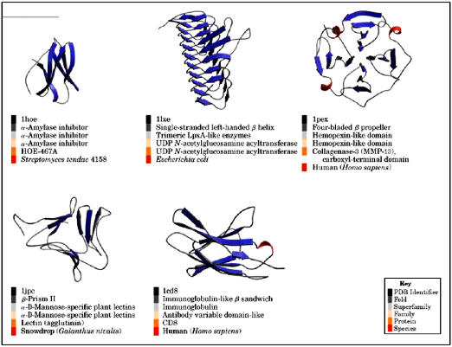
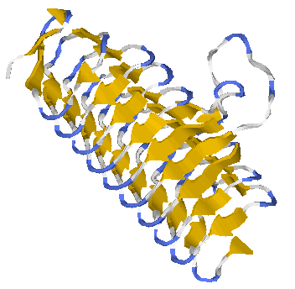
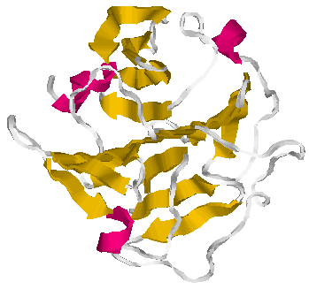
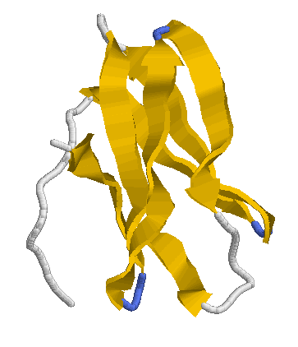
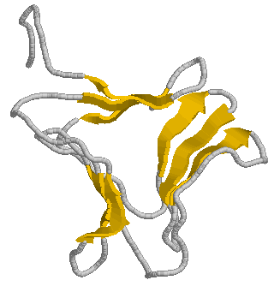
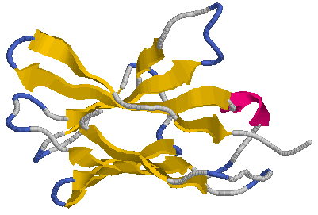
All α
Protein folds
Approx. 1400 identified so far; only “the 20” AA are needed to form all 1400
All β

Slide 9


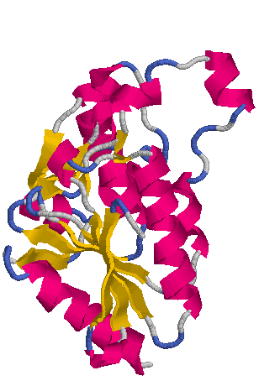


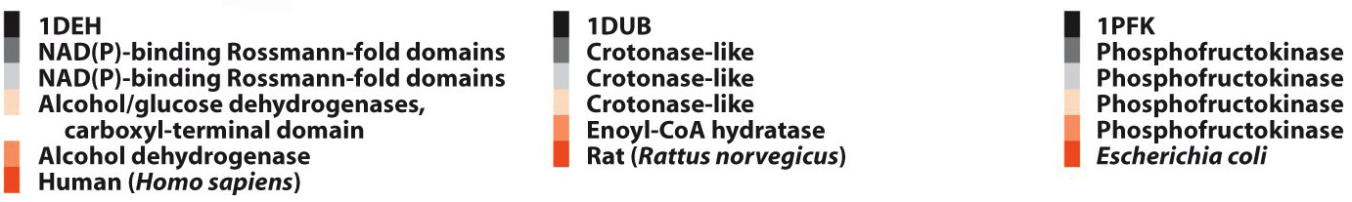


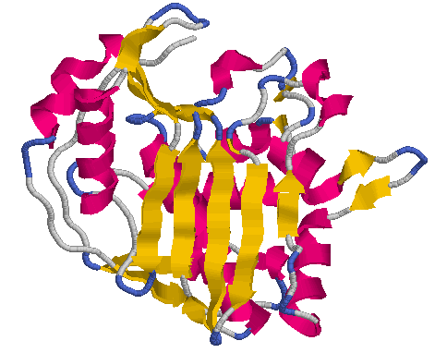
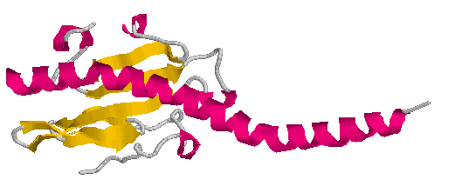
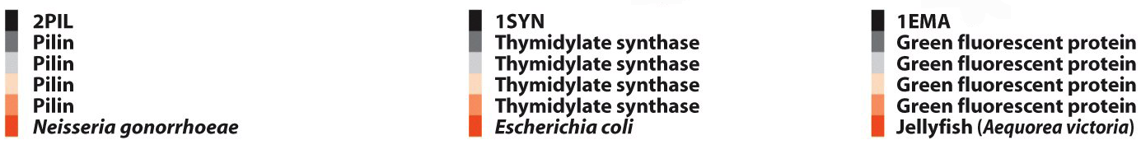
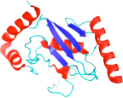

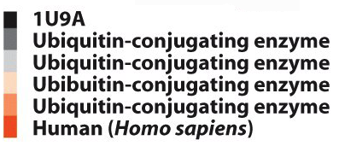
Mixed α AND β

Slide 10
All α
Protein folds
Approx. 1400 identified so far; only “the 20” AA are needed to form all 1400
Maybe not many more different folds exist?!
Why only these 1400?
All β
1. Limited ways to get stable combination of helices, β-sheets, turns, coils
2. That can fold quickly, in millisec to sec or min
3. Another category:
Intrinsically disordered proteins!
Most have large fraction of polar/charged residues, which tend to stay in water rather than to fold

Slide 11
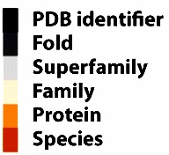
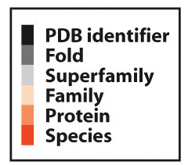
Folds
Mixed α AND β
Several different research groups publish "fold databases"
PDB -- Most up-to-date protein structures, links to SCOP, CATH, etc.
SCOP – Structural Classification of Proteins
CATH – Class, Architecture, Topology, Homology
SCOP classification:
PDB identifier
Fold
Superfamily
Family
Protein
Species

Slide 12
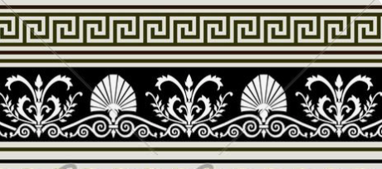
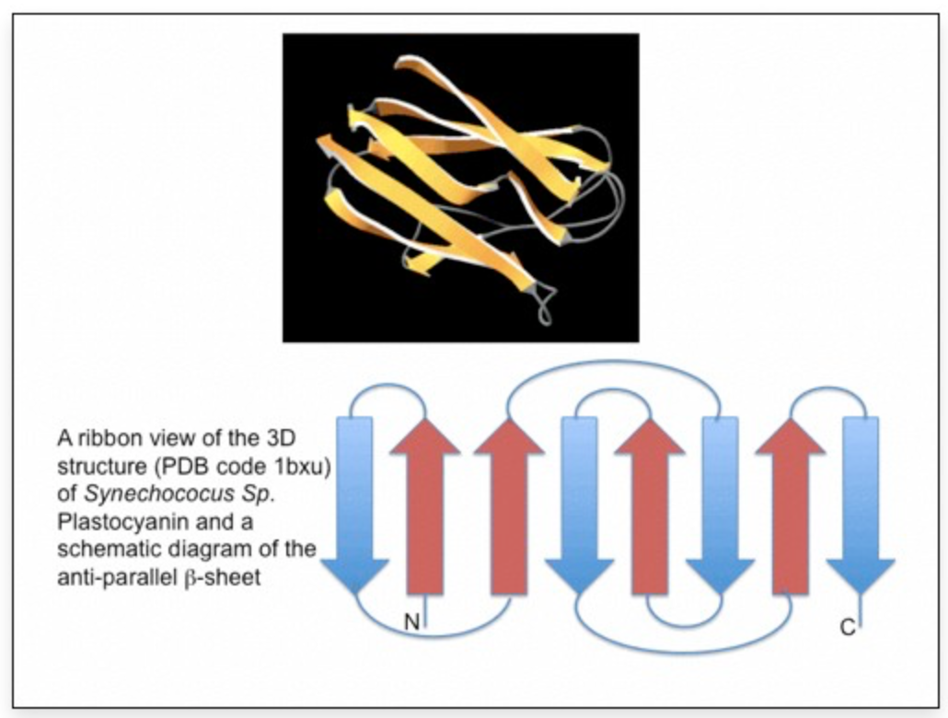
Fold Patterns Drawn in 2D
Topology diagram shows beta-sheet connections
Greek Key Motif (Jane Richardson, Duke U.)
https://proteinstructures.com/Structure/Structure/protein-motifs.html

Slide 13
Where we are, where we are going in the study of biochemistry:
What structures do we observe?
Protein structure
We are here
Coming soon
How do catalysts work?
Enzyme catalysis
How are enzymes controlled?
Regulation of enzymes
Biomembranes
Carbohydrates
Metabolism
METABOLISM
Interconnections and control of metabolism are based on proteins

